Slide 1

Big Data Analysis With IBM Databases
Cloud Computing Project Documentation

Slide 2

OBJECTIVES
The primary objective of this project was to perform in-depth big data analysis using IBM Cloud Databases. We aimed to extract valuable insights from a selected dataset and translate them into actionable business intelligence.

Slide 3

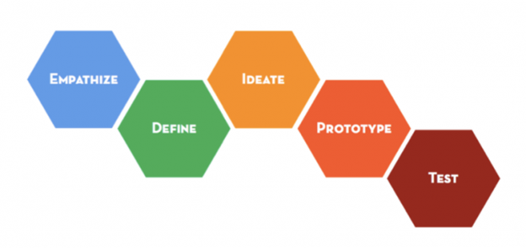
Design Thinking Process
I followed a design thinking approach to address the project's challenges effectively. This involved empathizing with the end-users, defining the problem, ideating potential solutions, prototyping the analysis, and testing our findings to ensure they meet the objectives.

Slide 4

Development Phases
This is about all the development phases of the project which includes four phases they will be overviewed in this document.
Phase 1
Phase 2
Phase 3
Phase 4

Slide 5
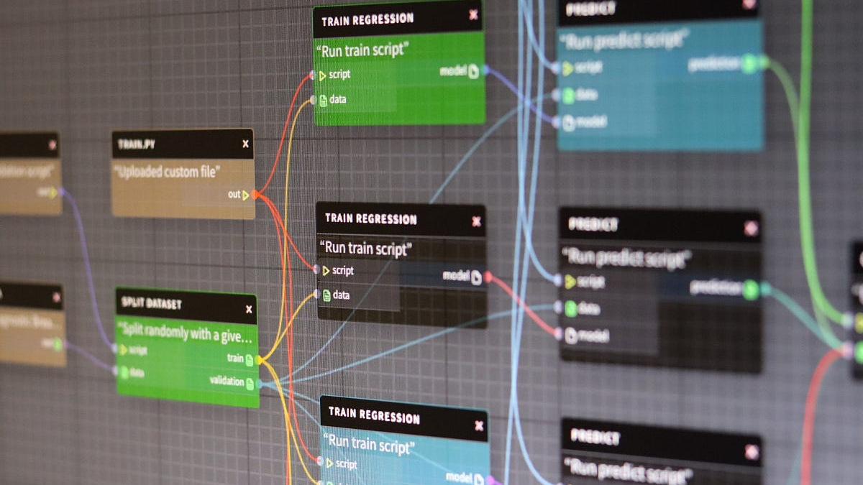
Phase 1
Data Collection
Collecting marketing data from various sources, including website traffic, social media, email campaigns, and customer databases.
Setting up data pipelines to ensure data ingestion and storage.

Slide 6

Phase 2
Data Cleaning and Preparation
Cleaning and preprocessing data to remove duplicates, missing values, and outliers.
Structuring the data for analysis

Slide 7

Phase 3
Database Setup and Data Analysis
We began by creating an IBM Cloud account and selected the appropriate database service, opting for Db2 as our database management system.
Utilizing advanced machine learning algorithms to perform customer segmentation and predictive analysis.
Analyzing customer behavior patterns, including click-through rates, conversion rates, and purchase history.
This Photo by Unknown author is licensed under CC BY.

Slide 8
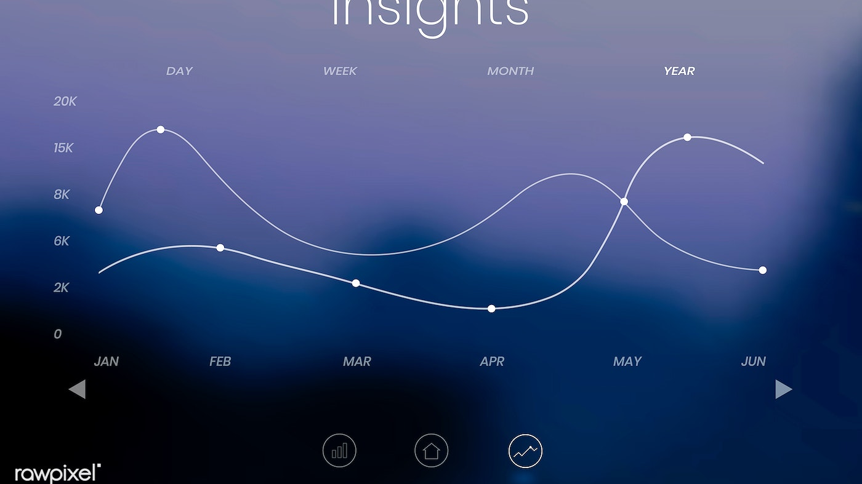
Phase 4
Reporting
Creating visualizations using tools like Tableau and Power BI to represent key insights.
Developing interactive dashboards for real-time monitoring
Insights and Recommendations
Extracting valuable insights, such as identifying the most effective marketing channels, customer segments, and the best times to run campaigns.
Recommending actionable strategies to optimize marketing efforts.

Slide 9


Phase 5
Dataset Description
Selected Dataset: We collected data from multiple sources, IBM
Data Size: The dataset comprises millions of rows of data
Data Fields: It includes information on Average salary
Database Setup:
We implemented a cloud-based relational database system to store and manage the dataset securely.

Slide 10
Database Setup:
We implemented a cloud-based relational database system to store and manage the dataset securely.
Analysis Techniques:
Machine Learning: We employed machine learning algorithms for customer segmentation, predictive modeling, and personalized marketing.
Statistical Analysis: Conducted statistical tests to identify significant correlations and trends.
Text Mining: Analyzed customer feedback and social media comments to understand sentiment and customer opinions.

Slide 11

Visualization Methods:
Utilized Tableau for creating dynamic visualizations, including heatmaps, bar charts, and line graphs.
Developed interactive dashboards for real-time performance monitoring.
Business Insights:
1.Key Findings
2.Optimization
3.Personalization
This Photo by Unknown author is licensed under CC BY-SA-NC.

Slide 12

Conclusion: This big data analysis project successfully transformed raw marketing data into valuable insights, optimizing marketing strategies and enhancing business outcomes.
CC BY.

